Slide 1
Only One Out of Five Archived Web Pages Existed as Presented
Scott G. Ainsworth, Michael L. Nelson, Old Dominion University
Herbert Van de Sompel, Los Alamos National Laboratory
DOI: http://dx.doi.org/10.1145/2700171.2791044
Naga Vamsi Krishna Pabbisetty
CS795/895
UIN : 01071855
2019-05-09
Old Dominion University

Slide 2
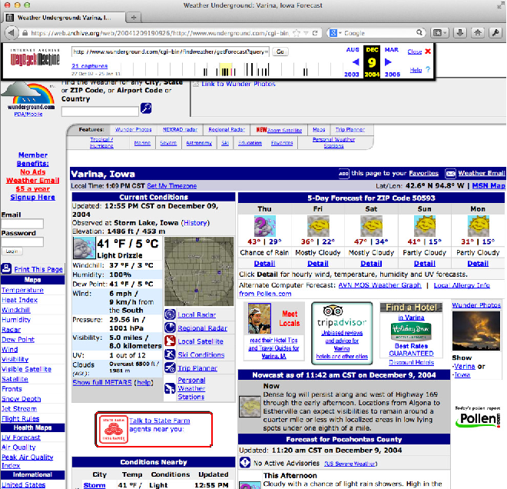
How a memento looks like
DOI> http://dx.doi.org/10.1145/2700171.2791044

Slide 3
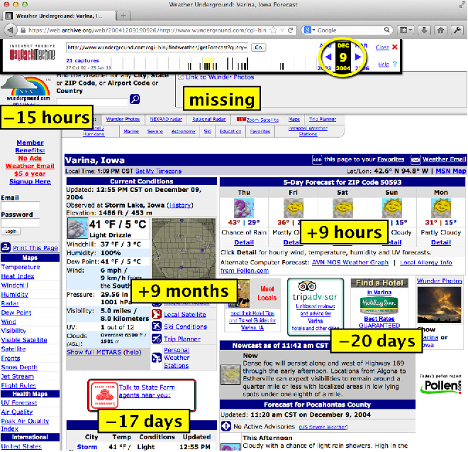
What it actually is!!
The information shown beside
the radar image about
the weather is not consistent
with the information shown in
the image.
The information says its cloudy
but the radar image shows
Otherwise.
DOI> http://dx.doi.org/10.1145/2700171.2791044

Slide 4
Completeness and Temporal Coherence
Completeness:
Completeness of a Memento as to its source
Temporal Coherence:
How much of a memento matches with its source
Reasons: Lack of resources to store the data, temporary/permanent unavailability of data

Slide 5
Markers used to determine Temporal Coherence
Prima Facie Coherent (green) – the resource was obtained after the HTML contents with its last modified before the timestamp of memento
Prima Facie Violative (red) - the resource was obtained after the HTML contents with its last modified after the timestamp of memento
Possibly Coherent (blue) – the resource was obtained before HTML contents were obtained
Probably Violative (yellow) - the resource was obtained after the HTML contents but lacks last modified

Slide 6
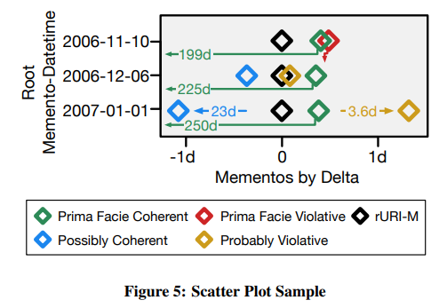
Mementos and their relationship with Temporal Coherence
DOI> http://dx.doi.org/10.1145/2700171.2791044

Slide 7
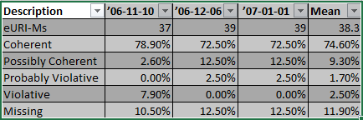
Data Monitored

Slide 8
Questions answered
How prevalent is temporal incoherence?
Current web archive user interfaces enable access to a single archive’s resources. If multiple archives are used, is temporal coherence improved?
The best memento for an embedded resource can be selected using many different heuristics. Currently, most web archives use the Minimum Distance heuristic. How do other heuristics compare?

Slide 9
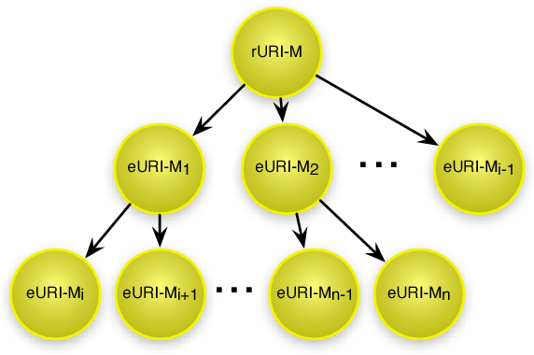
Composite Memento
DOI> http://dx.doi.org/10.1145/2700171.2791044

Slide 10
Heuristics and Source Constraint
Heuristics:
Minimum Distance (Mindist)
Last-Modified/Memento-Datetime Bracket (Bracket)
Source Constraint:
Single archive or multiple archives as source while composing composite memento
Multiple archives increases the chances for completeness

Slide 11
Data used
4 samples with 1000 URI-Rs selected randomly
Sources - DMOZ, search engine, Bitly, and Delicious
4000 sample URI-Rs in total

Slide 12
Procedure
Phase 1: Selection of rURI-Ms
Retrieve timemaps for all the URI-Rs
Select one URI-M per month
Phase 2: Recomposition (for every memento obtained above)
Download rURI-M
Extract eURI-Rs
Retrieve the eURI-R timemap
Select eURI-M for eURI-R
Download embedded memento
Recursion of steps in Phase 2

Slide 13
Results

Slide 14
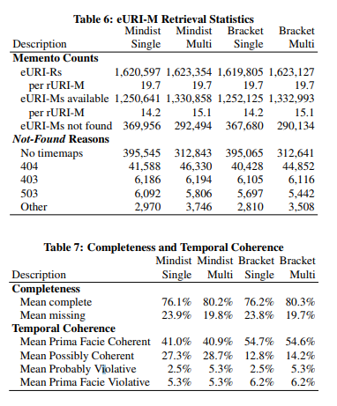
Data statistics
DOI> http://dx.doi.org/10.1145/2700171.2791044

Slide 15
Completeness and Temporal Coherence
Completeness:
Ratio of available mementos to required mementos
Increase by 4.1% for both heuristics
Temporal Coherence
Effect of multiple archives :
0.1% increase in temporal coherence
Reduced Prima Facie Coherence (only Internet archive returns last modified for eURI-Ms)
Increases Possibly Coherent mean by 4.1% and Probably Violative counts by 2.8% (increased number of eURI-Ms without last modified)

Slide 16
Heuristic and Temporal Coherence
Mindist is generally used while archiving.
Effects of Bracket heuristic:
Increased Prima Facie Coherent eURI-Ms by 13.7%
Decreased Possibly Coherent eURI-Ms by 14.5%
Decreased Prima Facie Violatives eURIMs by 0.9%

Slide 17
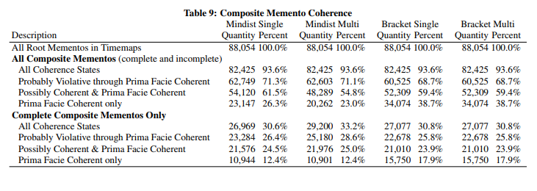
Composite Memento Coherence
1,244 sample URI-Rs had no timemaps or had restricted access
2756 URI-Rs were available
12.4%–17.9% are both 100% Prima Facie Coherent and 100% complete
DOI> http://dx.doi.org/10.1145/2700171.2791044

Slide 18
Future Work
Redirection and missing mementos – a heuristic to find a reasonable alternate of a missing URI-M
Duplicates and similarities – every archive adds additional information which is archive specific into memento. This kind of changes do not affect user but would affect machines. There can be raise in Prima Facie or Possibly Coherent and decrease in others if this were possible increasing coherence.
Communicating skills – Indicating the coherent status of a memento to the user

Slide 19
Conclusion
Completeness increase by 4.1% when multiple archives are used (but no significant impact on temporal coherence)
Bracket heuristic improved temporal coherence when compared with Minimum distance heuristic
Multiple archives maximizes completeness
For coherence, best results are provided by Bracket heuristic with a single archive
17.9% of composite mementos present in web archives are both complete and Prima Facie Coherent

